Slide 1


Notes:
Good day! Welcome to Our Doors are Open: an Accessible Welcome for People with Disabilities in Places of Worship! First off, we want to thank the Calvin Institute of Christian Worship for the funding to continue this part of our project.
Our team is part of the Inclusive Design Research Centre (IDRC) at the Ontario College of Art and Design University (OCAD U). The IDRC is a research and development centre at OCAD University where an international community of open-source developers, designers, researchers, advocates, and volunteers work together to ensure that emerging information technology and practices are designed inclusively – that is, with multiple body types in mind.
After we introduce ourselves, we'll start off with a quick video about our project, so we can give you a better idea of what we do...

Slide 2
Welcome!
Notes:
Introduction: in one sentence, please share...
1. Your name,
2. How you spend your time, and
3. How you heard about our project
Notes on A/V Access:
Verify the Teams connection!
Contact the parish about their equipment
If they don’t have a projector / proper Teams connection, IDRC can provide you with one

Slide 3

Notes:
https://www.youtube.com/watch?v=CimPvtlfYos

Slide 4
Who are we?
Our Doors Are Open helps faith communities across Ontario, Canada, and the world, including churches, to welcome people with all abilities. We want to create communities that:
Recognize barriers that prevent the full participation of people with disabilities;
Brainstorm simple and creative solutions to remove these barriers; and
Welcome and fully include people with disabilities in every community.
Notes:
3 minutes
Who are we?
Our Doors Are Open helps faith communities across Ontario, Canada, and the world, including churches, to welcome people with all abilities. We want to create communities that:
Recognize barriers that prevent the full participation of people with disabilities;
Brainstorm simple and creative solutions to remove these barriers; and
Welcome and fully include people with disabilities in every community.

Slide 5
Today’s Goals
At the end of this session, you will:
Be able to describe one or more welcoming quality/ies of your community
Name one or more ways that people with disabilities can actively participate in your community
Walk away with at least one immediate actionable goal re: inclusion
Notes:
1 minute
Today’s Goals
At the end of this session, you will:
Be able to describe one or more welcoming quality/ies of your community
Name one or more ways that people with disabilities can actively participate in your community
Walk away with at least one immediate actionable goal re: inclusion

Slide 6
Today’s Agenda
Welcoming and Inclusion
Creating an Access Plan: Brief Accessibility Checklist
Promoting Active Participation
Ways to Reach Out
Notes:
1 minutes
Today’s Agenda has four connected parts.
We want to define and discuss:
Welcoming and Inclusion
Brief Accessibility Checklist
Promoting Active Participation
Ways to Reach Out (to Members Old and New)

Slide 7
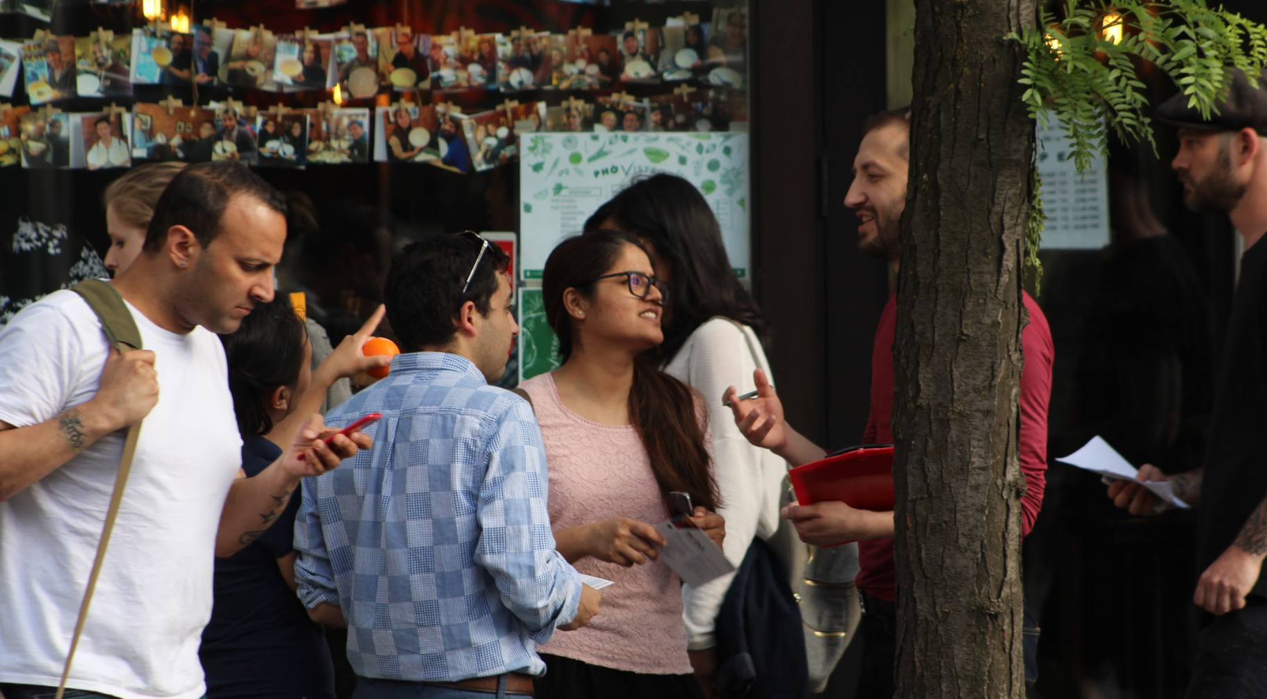
Let’s break the ice
Notes:
5 minutes. Choose one question to ask the group...
Ask questions till most of the group joins in (raise hand reaction or on camera)
“how many of you have a disability?”
“how many of you have a family member with disability?”
“how many of you have a friend with disability?”
“How many of you have a co-worker or neighbour with disability?”
“How many of you know someone who has a close family/friend with a disability?”
* in-person only: you can get audience to clap, stand up, raise hand, etc.
**Zoom: ask people to 'raise hand" in camera or using Zoom reaction
Video
Find a video highlighting the values of inclusion/accessibility. After watching the video, ask audience for comments. Make sure that the video is captioned.
Option 1: https://www.youtube.com/watch?v=6SnXBKEfr2s
Option 2: https://www.youtube.com/watch?v=rjluLV1F-UI
Singing
Choose a song that fits the presentation. Use multiple instruments if possible.
Learn to sign a song
Meditation
In-person only: Yoga

Slide 8
What exactly is welcoming?
Notes:
5 minutes
Begin definitions with these questions:
Think of a time when you entered into a new space, indoor or outdoor, and you felt you were genuinely welcomed.
What does the space look like? Where are you positioned within this space? What do the faces look like? What are they saying? What does the space smell like? Are people showing interest in you, and/or what you're doing?
In-person Materials (replaced by chat box with Zoom):
Post-it notes
Markers
In-person: Write each of these welcoming qualities on post-it notes. Cluster the notes (possibly into three clusters: attitude, space and materials/tools)
Zoom: cluster all chat-conversations in three categories, as above: attitude, space, and materials/tools.
(someone besides the presenter may need to take notes)

Slide 9
What is Inclusive Thinking?
● Inclusive thinking means keeping the diversity and uniqueness of every individual in mind.
● Inclusive thinking means changing habits and behaviors (embodying access)
● It means welcoming all people, from all walks of life, with their diverse modes of experience.
Notes:
5 minutes
Inclusive thinking means keeping the diversity and uniqueness of each individual in mind. The needs of individuals with disabilities are more diverse than those of people of able body, so a mass-produced solution does not work well for all of us.
Inclusive thinking means changing habits and behaviours, too, in order to embody access. Your community may need to consciously bring inclusive thinking into all its activities, before these inclusive habits are developed. Forming more hospitable thought patterns can be easier than you expect.
Who's missing from our analysis? Webb-Mitchell: church as "sanctuary and servant" of PWDs; Eiesland and "laying on of hands."
We recommend, as a primary strategy of inclusive thinking, a very simple approach:
Just ask. Just listen (like Jesus in Mark 5:25-34)

Slide 10
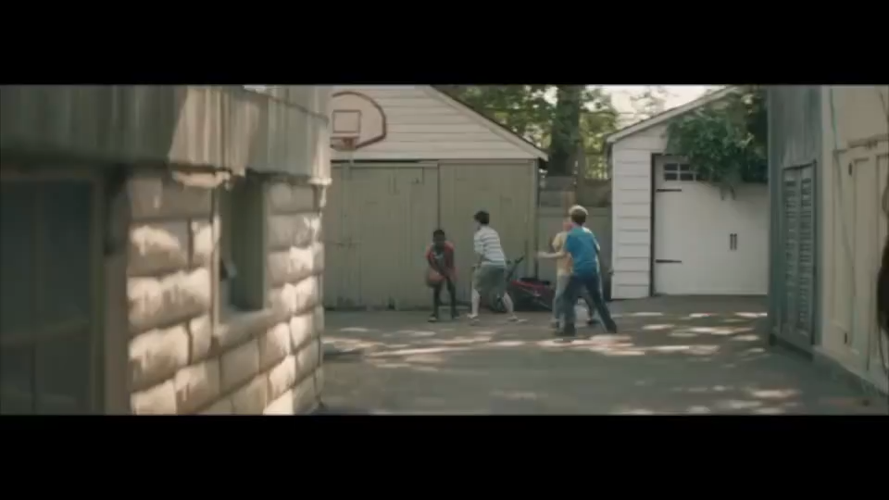
How to Use Inclusive Thinking
Notes:
5 minutes
What about this video demonstrated inclusive thinking?

Slide 11
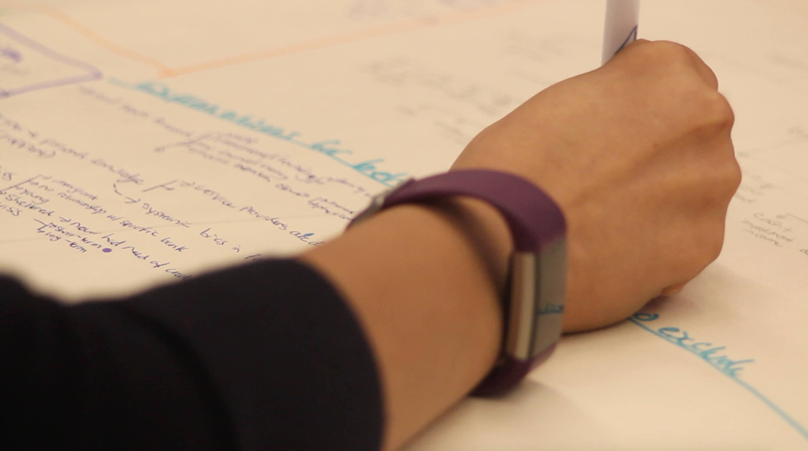
Getting Organized
Churches can be available to people with disabilities:
Form an accessibility committee
Identify barriers
Create a plan for greater access
See Guide for Accessible Congregations pg. 12
Notes:
To start making your faith community more accessible, we recommend that you follow these three steps:
Form an accessibility committee
Identify barriers
Make a plan

Slide 12
ACCESSIBILITY COMMITTEES
Accessibility committees – one aspect of solidarity with people with disabilities – consist of champions for accessibility for people with disabilities. Committees should:
Meet regularly, at least 3x per year;
Advocate for members with disabilities;
Plan renovations to spaces and practices;
Troubleshoot challenges for people with disabilities;
Develop short- and long-term financial and organizational plans
See Guide for Accessible Congregations pg. 12
Notes:
An accessibility committee embodies solidarity with people with disabilities; they're made up of the community’s champions for accessibility for people with disabilities.
Every good accessibility committee should:
Meet regularly, at least three times per year;
Discuss the needs of the members with disabilities;
Plan ways to change the space and their practices in order to improve access;
Find (and take steps to repair) areas that have challenges for people with disabilities;
Develop short- and long-term financial and organizational plans so that the community can welcome as many people with diverse needs as possible.
Do you have an accessibility committee in your community?
No? Then how would you like to go about /creating/ one?

Slide 13
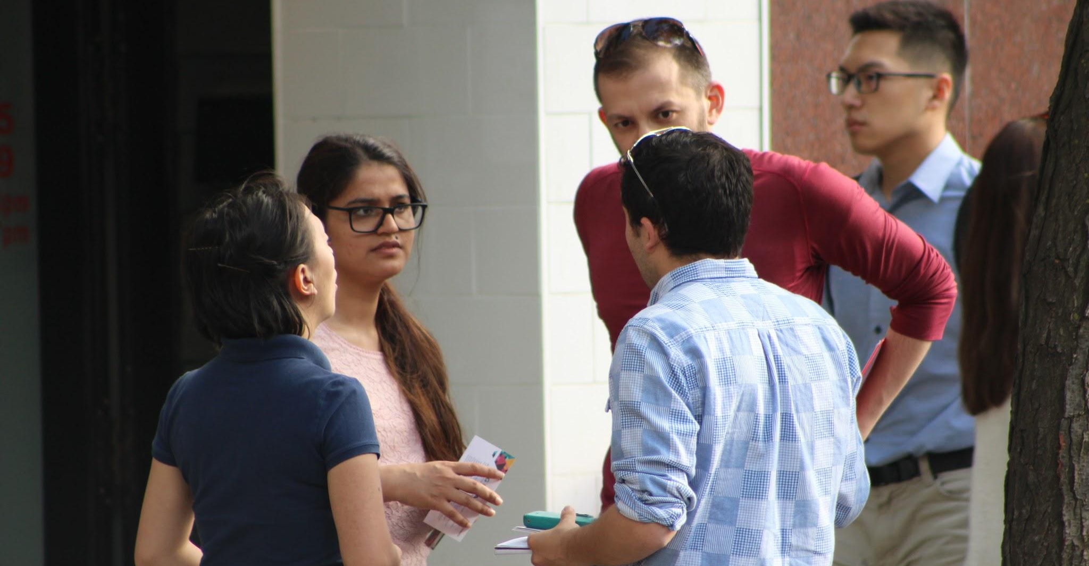
Identify Barriers
Take a moment to review our checklist, one way to identify barriers and advocate for and with people with disabilities.
What are some of your community’s accessible and inclusive features?
Which features could be added to your community?
See Guide for Accessible Congregations pg. 13
Notes:
10 minutes
*Give the print checklist; share the PDF file on Zoom.
The checklist can help people identify their community’s accessible and inclusive features, and help them to evaluate their solidarity with people with disabilities in and near their community.
Be sure to acknowledge what they are already doing well.
Not all the items on the checklist may be applicable to the community in question; highlight that, if applicable.
Next few slides will expand on parts of the checklist - accessibility committee, accessible and alternative formats (of communication), and so on.

Slide 14
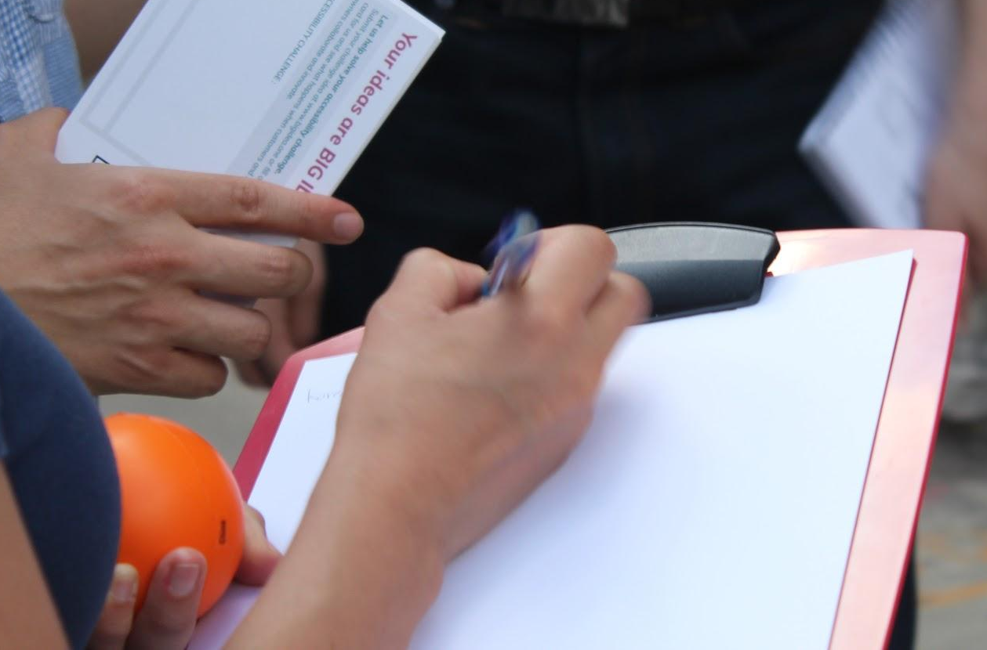
Make a Plan
Look at the items that have been checked “not yet.”
Select an order for the committee to address each one.
For each item, determine what resources the committee will need, and how you will get them.
Create a short-term and long-term plan that will let you address each item.
See Guide for Accessible Congregations pg. 17
Notes:
1) Look at the items that have been checked “not yet.” With your committee, consider which of the items you can remedy easily and which ones will take more time and resources. There are tips in the Getting Down to Work section below to help you learn ways to remove barriers; you might need to consult that section.
2) Select the order in which you want to address each item. You may want to start with the easier ones, alongside one harder item.
3) For each item, determine both what resources (people, material, money) you will need, and how you will get them.
4) Have a short-term and long-term plan that will let you address each item. Your short-term plan should have more details and specific dates. Your long-term plan may have step-by-step goals like setting aside funds or applying for grants.

Slide 15
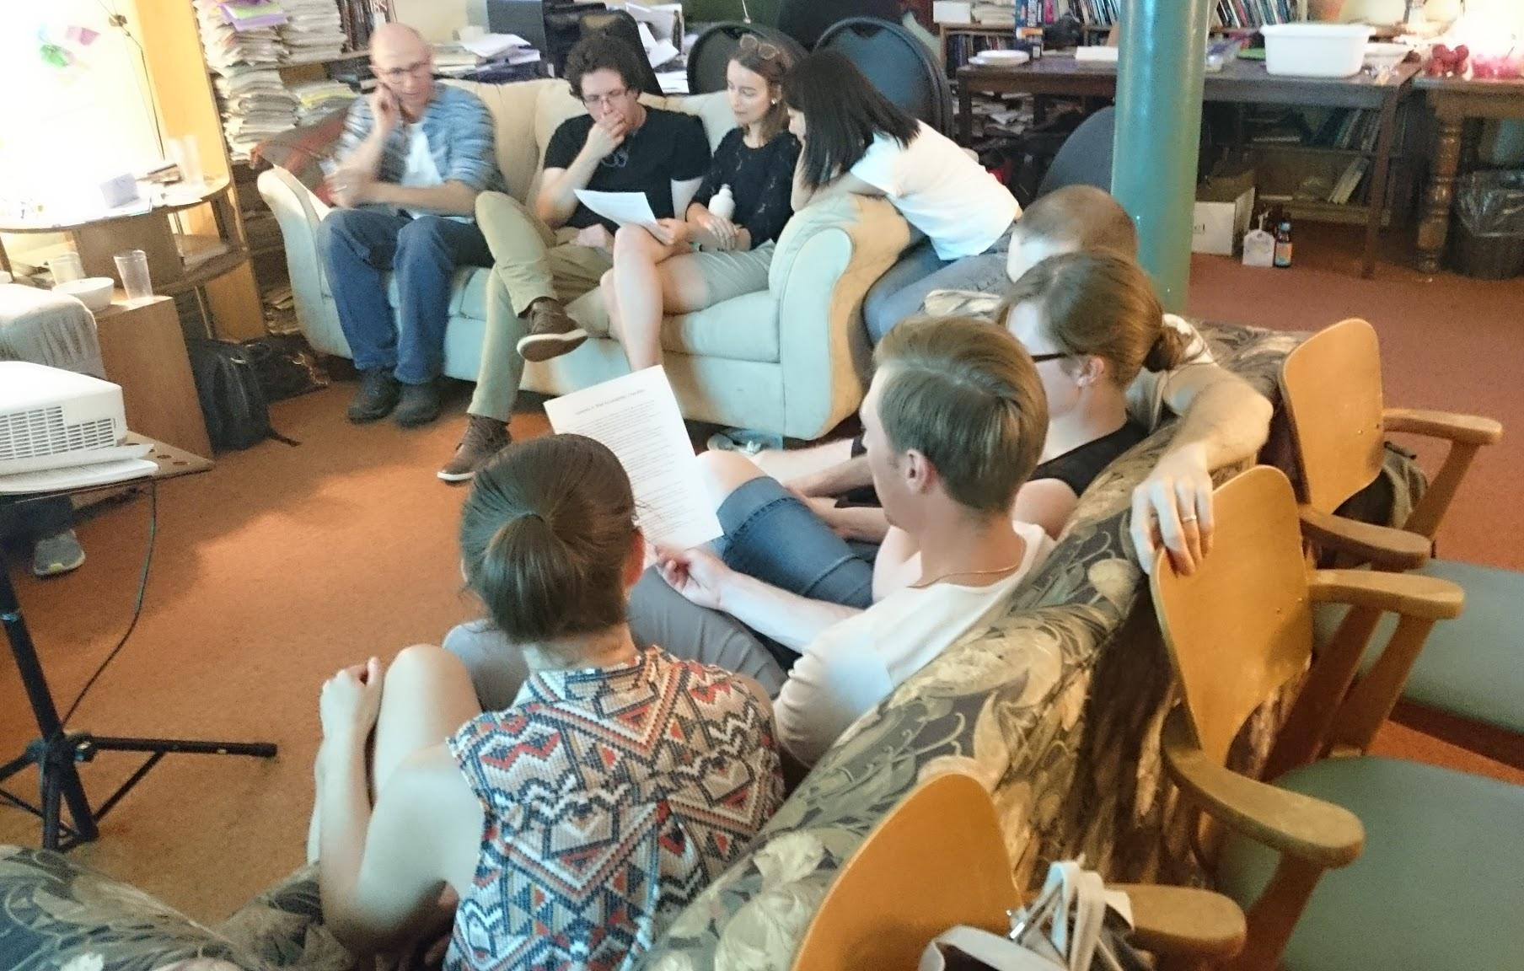
Getting Down to Work
Strategies for:
Shifting Attitudes & Promoting Active Participation
Improving Communications
Making Facilities Accessible
See Guide for Accessible Congregations pg. 18
Notes:
This section will involve the following three steps:
Shifting Attitudes & Promoting Active Participation
Improving Communications
Making Facilities Accessible

Slide 16
Shifting Attitudes &
Promoting Active Participation
Listen to the needs of people with disabilities in your community.
Let people with disabilities volunteer on a flexible schedule.
Discuss who the most welcoming people are in your community, & what they do.
Offer opportunities for people to volunteer in groups or pairs.
Make available flexible time commitments, and/or partnering arrangements, that will enable individuals with episodic disabilities to volunteer.
Ask people what you can do to support their commitments.
See Guide for Accessible Congregations pg. 18
Notes:
Many strategies can help your community to promote active participation of people with disabilities:
Listen to the needs of people with disabilities, and caregivers, in your community.
Ask people with disabilities to volunteer and lead in the different areas of your community.
Discuss who the most welcoming people are in your community & what they do.
Offer opportunities for people to volunteer in groups or pairs.
Offer flexible time commitments and/or partnering arrangements that will enable individuals with episodic disabilities to volunteer.
Ask people with disabilities, and caregivers, what you can do to support their commitments.
*Ask participants for their own ideas

Slide 17
Improving Communications
New information: think about what might help someone who has vision loss, hearing loss, or an intellectual disability to understand it.
Existing information: think about making it available in an accessible format; e.g., using large print for someone with vision loss.
Use clear fonts and contrasting colors for written documents.
Use captions, sign language, and translators to accommodate more members.
Hire people with disabilities to create content for your community.
See Guide for Accessible Congregations pg. 22
Notes:
The same strategies can also apply to communication within your community:
When you create new information, think about what might help someone who has vision loss, hearing loss, or a learning disability to understand it.
For existing information, think about making it available in an accessible format; for example, using large print for someone with vision loss.
Use clear fonts and contrasting colours for any documents you hand out or display.
Incorporate various forms of visual, text, and audio elements into communication so that people can understand your message through the medium they feel most understandable.
Use captions, sign language, and translators to accommodate more members.
Examples:
Large print text documents
Recorded audio
Electronic documents (plain text, accessible document)
Braille
Sign language
Caption
Pictures
Hire people with disabilities to create content for your community.

Slide 18
PHYSICAL ACCESSIBILITY
Consider how people are going to arrive at your space.
Provide information about accessible parking and wheelchair access.
Make your indoor and outdoor pathways free of barriers.
If you have elevators, try to make them fully inclusive for diverse members.
Provide inclusive, clear, high-contrast signage.
Check the acoustics. It is important to provide minimal echo.
Indicate the location of accessible bathrooms.
Provide a quiet area with dim lighting.
See Guide for Accessible Congregations pg. 25
Notes:
Significantly, comparable strategies also apply to physical spaces:
Consider how people are going to arrive at your space.
Consider offering diverse transportation options, including carpools, to members with disabilities.
Provide information about accessible parking and wheelchair access.
Check your outdoor and indoor pathways to be sure that they are free of barriers.
If you have elevators, try to make them fully inclusive for diverse members.
Provide inclusive, clear, high-contrast signage.
Check the acoustics in your space. It is important to provide minimal echo.
Indicate the location of accessible bathrooms.
Be sure that all electrical cables and cords are securely covered for safe crossover.
Provide a quiet area with dim lighting.

Slide 19

Let’s try out our strategies!
Choose one or two things you could make happen in your community.
Notes:
5 minutes
Now that we've discussed these many strategies, choose one or two things you could make happen in your community.

Slide 20
What’s next?

Slide 21
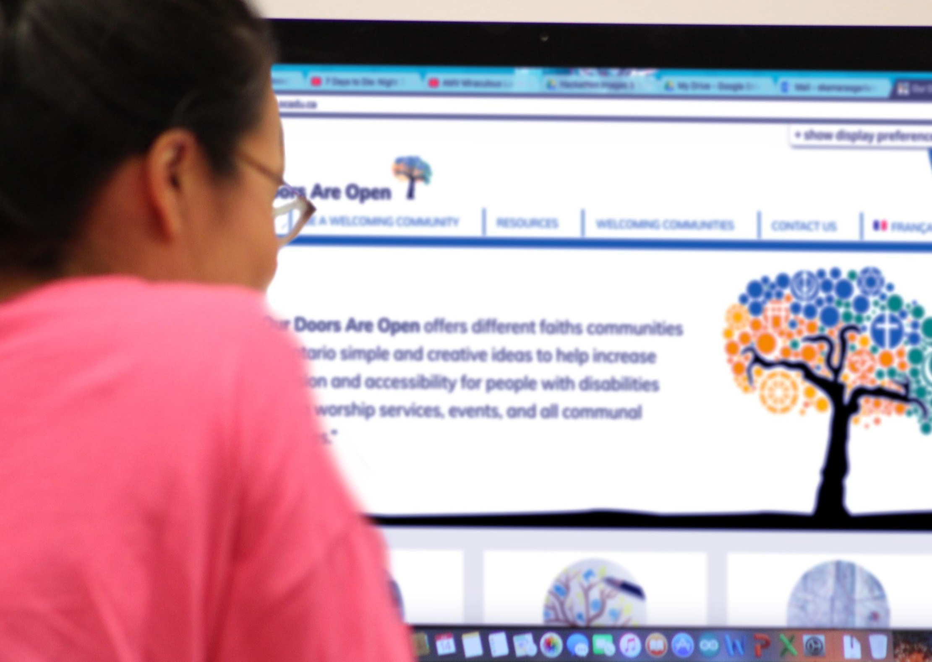
Reach out to new members
Bulletins/newsletters
Social media
Websites
Email (e.g., listservs)
Mapathons
Disability organizations
Advocacy organizations
See Guide for Accessible Congregations pg. 28
Notes:
10 minutes
Show examples of each.
It may be helpful to use examples from different religious and secular communities.
Whenever possible, hire people with disabilities to create content for your community. Be sure to offer the information in various alternative formats.

Slide 22
Want more information?
Website: http://opendoors.idrc.ocadu.ca/open-your-doors/
Our Doors are Open Guide
Resources
Share your own creative ideas to welcome and include with us!
Facebook: https://www.facebook.com/OurDoorsAreOpen/
Twitter: https://twitter.com/OpenDoorsIDRC
Notes:
5 minutes
Visit our website for more examples from different communities and resources!
Also share your creative ideas to welcome and include people with disabilities!

Slide 23
OTHER RESOURCES
CRCNA Inclusion Handbook: Everybody Belongs, Serving Together – a good summary resource for inclusion of people with disabilities in churches
Institute on Theology and Disability: https://faithanddisability.org/institute/ AND https://www.facebook.com/groups/itdcommunity
Enabling Accessibility Fund: https://www.canada.ca/en/employment-social-development/programs/enabling-accessibility-fund.html (Government of Canada funding for accessible buildings)

Slide 24
Thank you for opening your doors!

